Slide 1

CONSUMER SENTIMENT ANALYSIS
Lakshay Katyal
katyallakshay97@gmail.com

Slide 2
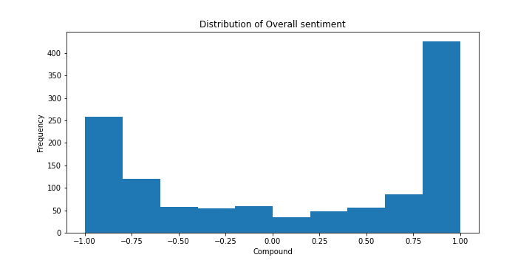
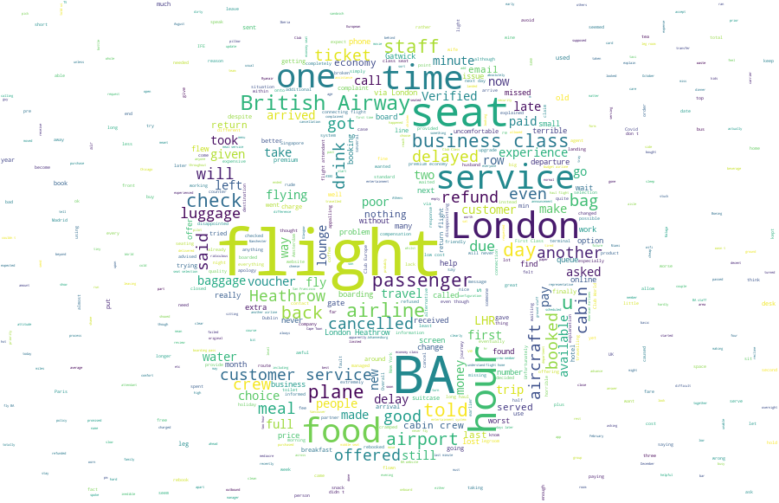
The plot depicts well distributed sentiments with a slight inclination towards positive reviews. 54.5% of the sentiments seem to be on the brighter side while the remaining 45.5% show dissatisfaction.
With 45.5% negative views, we should shift our focus on improving upon these points.
This Word Cloud summarises the negative talking points giving us starting points for improvements.

